Slide 1


Social Buzz Big Data Analysis

Slide 2


Today's agenda
Project Recap
To provide a high-level overview of the business problem we’re tackling and the precise requirements, we will provide a summary of the entire project
Problem
We will get into the particular issue that the Data Analytics team has been concentrating on and provide some context for why this iz zuch significant issue
Analytics Team
I’ll start by outlining the issue and then discuss the team that is in charge of handling this assignment on our end.
Process
After that I’ll go into the general steps we took to do this assignment so you can fully understand how we approach task of this nature .
Insights
Lastly, I will review all significant findings and often them as a collection of understanding and illustration from our end.

Slide 3

Social Buzz is a rapidly growing technology startup unicorn company that needs to quickly adjust its global reach.
Accenture has began a 3 months POC focusing on these tasks:
An audit of Social Buzz big data practice
Recommendation for Successful IPO
An examination to determine the top 5 categories of Social Buzz
Project Recap

Slide 4

Problem
In recent years the customers has grown to the enormous extent and they lack the internal resources to manage it.
Over 100000 post every day were posted on Social Buzz. Totaling 36,500,000 post annually. Since all data is unstructured it is difficult to make sense it all.
Combining tables from the sample data set.
An analysis to find top 5 popular categories of content that were posted on social buzz.

Slide 5



Andrew Fleming
Chief technology architect
The Analytics team
Marcus Rompton
Senior Principle
Vikash Singh
Data Analyst

Slide 6
Process
1
Data Understanding
Data Cleaning
2
3
Data Modelling
4
Data Analysis
5
Uncover Insights

Slide 7

Insights
16
1897
MAY
Reactions To “Animals”
Month With Most Posts
unique categories

Slide 8
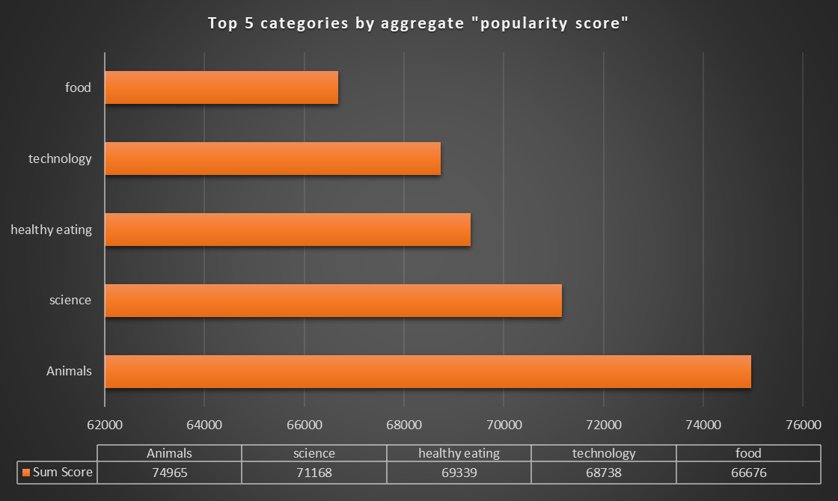

Slide 9
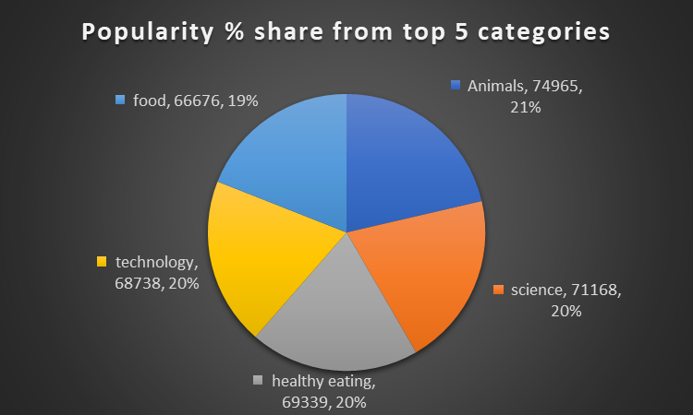

Slide 10

Analysis
Animals and science are two of the most popular content categories, this shows that people enjoy “real-life” and “factual” content the most. So I would recommend that you keep creating more content related to these two categories.
Insights
Summary
Food is a common theme with the top 5 categories with “Healthy Eating” ranking as one of the highest. This may give an indication to the audience within your user base. You could use the insights to create a campaign work with healthy eating brands to boost user engagement.
Next Steps
It should come as no surprise that technological content is among the top categories given the advertisement of technology. It indicates that users like your technological material. Working with some of the biggest digital companies in the world is something I would suggest doing because it would undoubtedly increase user engagement.

Slide 11
Thank you!
ANY QUESTIONS?

Slide 12
